Slide 1
Chapter 2 Graphs, Charts, and Tables – Describing Your Data
A Course in Business Statistics
4th Edition

Slide 2

A Newspaper Article: A local one

Slide 3
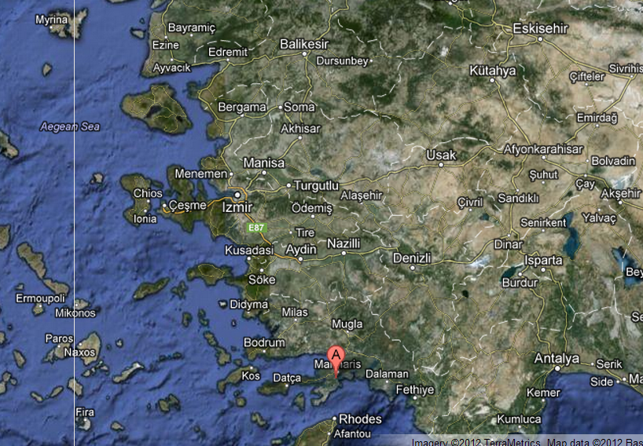
A Newspaper Article: A local one

Slide 4
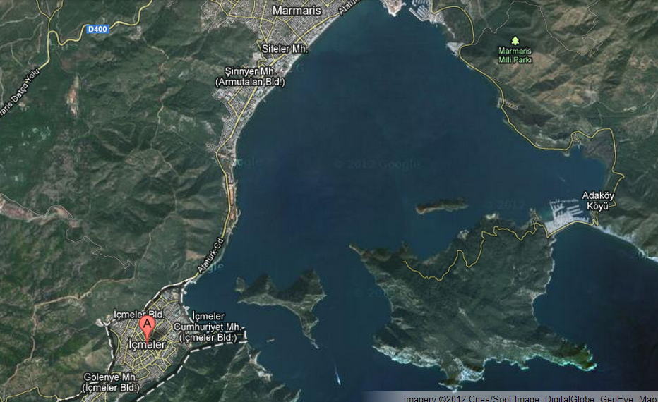
A Newspaper Article: A local one

Slide 5


Slide 6
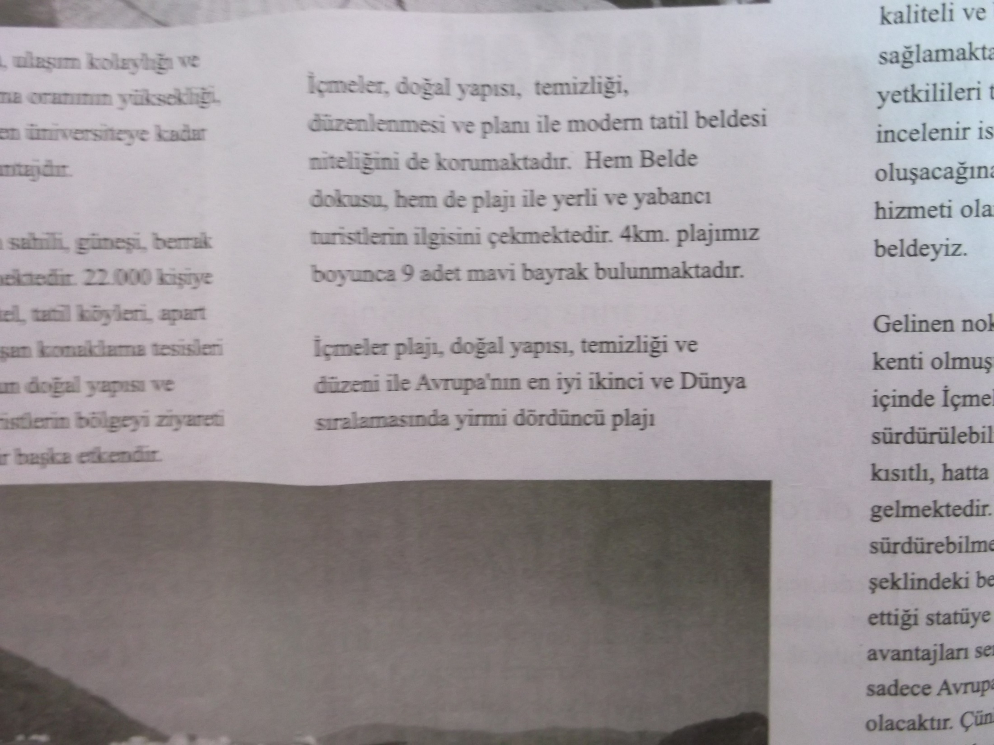

Slide 7
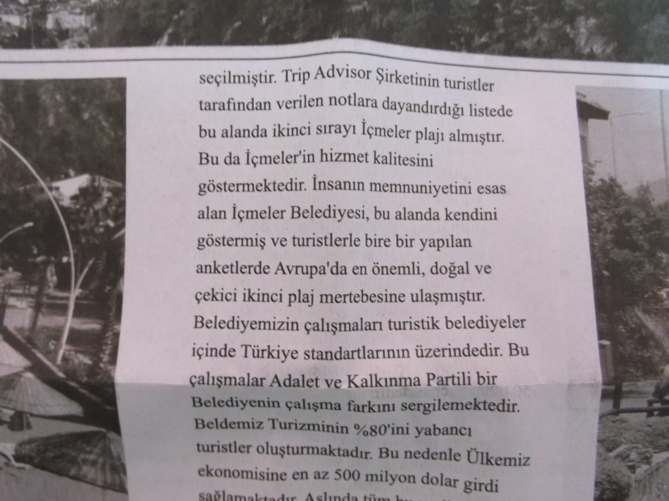

Slide 8
THINK ABOUT THIS SURVEY
WHAT IS WRONG WITH IT?
HOW CAN WE TRUST THE RESULTS?
etc.

Slide 9
Chapter Goals
After completing this chapter, you should be able to:
Construct a frequency distribution both manually and with a computer
Construct and interpret a histogram
Create and interpret bar charts, pie charts, and stem-and-leaf diagrams
Present and interpret data in line charts and scatter diagrams

Slide 10
A Reminder: Data Types
Data
Qualitative Data
Quantitative Data
Time Series Data
Location Data
Categorical
Discrete
Continuous

Slide 11
You collected data
either on your own (primary data source)
or
using the available sources (secondary data source)

Slide 12
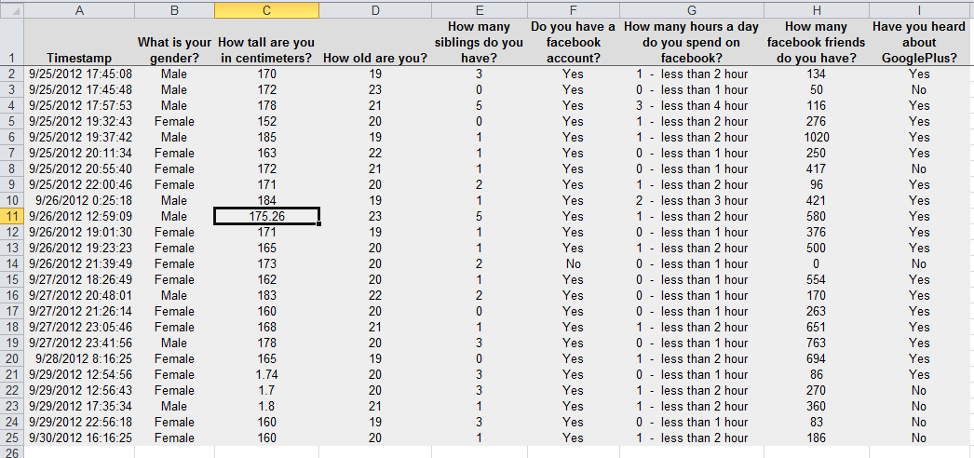
Without Any Attempt: Raw Data

Slide 13
Now it is Time to Organise Your Data
How?
Use Frequency Distributions (Tables)
Use Graphs

Slide 14
TABLES
Frequency Tables for
Qualitative Data
Gender
Yes/No questions
Quantitative Data
Discrete Data
Ungrouped – Grouped Frequency Table
Continuous Data
Grouped Frequency Table

Slide 15
Frequency Distributions
What is a Frequency Distribution?
A frequency distribution is a list or a table …
containing the values of a variable (or a set of ranges within which the data falls) ...
and the corresponding frequencies with which each value occurs (or frequencies with which data falls within each range)

Slide 16
Why Use Frequency Distributions?
A frequency distribution is a way to summarize data
The distribution condenses the raw data into a more useful form...
and allows for a quick visual interpretation of the data

Slide 17
The Basic Rules for Freq. Tables
The table must have a number and an explanation on top of the table regarding the information in it.
Measurement levels and the categories belonging to each variable must be clearly defined
The order of the categories/values in categorical variables should be done based on logic, in quantitative variables should be based on ascending/descending order
Sums should be provided
Source of the data at the end of the table

Slide 18

Frequency Distribution: Discrete Data
Discrete data: possible values are countable
Example: An advertiser asks 200 customers how many days per week they read the daily newspaper.
Number of days read | Frequency
0 | 44
1 | 24
2 | 18
3 | 16
4 | 20
5 | 22
6 | 26
7 | 30
Total | 200

Slide 19
Relative Frequency
Relative Frequency: What proportion is in each category?
Number of days read | Frequency | Relative Frequency
0 | 44 | .22
1 | 24 | .12
2 | 18 | .09
3 | 16 | .08
4 | 20 | .10
5 | 22 | .11
6 | 26 | .13
7 | 30 | .15
Total | 200 | 1.00
22% of the people in the sample report that they read the newspaper 0 days per week

Slide 20
Frequency Distribution: Continuous Data
Continuous Data: may take on any value in some interval
Example: A manufacturer of insulation randomly selects 20 winter days and records the daily high temperature
24, 35, 17, 21, 24, 37, 26, 46, 58, 30,
32, 13, 12, 38, 41, 43, 44, 27, 53, 27
(Temperature is a continuous variable because it could
be measured to any degree of precision desired)

Slide 21
Grouping Data by Classes
Sort raw data in ascending order:
12, 13, 17, 21, 24, 24, 26, 27, 27, 30, 32, 35, 37, 38, 41, 43, 44, 46, 53, 58
Find range: 58 - 12 = 46
Select number of classes: 5 (usually between 5 and 20)
Compute class width: 10 (46/5 then round off)
Determine class boundaries:10, 20, 30, 40, 50
Compute class midpoints: 15, 25, 35, 45, 55
Count observations & assign to classes

Slide 22
Frequency Distribution Example
Data in ordered array:
12, 13, 17, 21, 24, 24, 26, 27, 27, 30, 32, 35, 37, 38, 41, 43, 44, 46, 53, 58
Frequency Distribution
Class Frequency
Relative
Frequency
10 but under 20 3 .15
20 but under 30 6 .30
30 but under 40 5 .25
40 but under 50 4 .20
50 but under 60 2 .10
Total 20 1.00

Slide 23
GRAPHS
For Qualitative (Categorical) Data
Bar Charts and Pie Charts
For Quantitative Data
Frequency Distributions and Histograms
Stem and Leaf Diagrams
For Time Series Data
Line Charts
For Relationship (2 variables)
Scatter Diagrams

Slide 24
Graphing Categorical Data
Categorical Data
Pie Charts
Bar Charts
Pareto Diagram

Slide 25
Bar and Pie Charts
Bar charts and Pie charts are often used for qualitative (category) data
Height of bar or size of pie slice shows the frequency or percentage for each category

Slide 26
Pie Chart Example
Current Investment Portfolio
Investment Amount Percentage
Type (in thousands $)
Stocks 46.5 42.27
Bonds 32.0 29.09
CD 15.5 14.09
Savings 16.0 14.55
Total 110 100
Savings
15%
Stocks
42%
CD 14%
(Variables are Qualitative)
Bonds 29%
Percentages are rounded to the nearest percent

Slide 27
Bar Chart Example

Slide 28
Pareto Diagram Example
% invested in each category (bar graph)
cumulative % invested (line graph)

Slide 29
Bar Chart Example
Number of days read | Frequency
0 | 44
1 | 24
2 | 18
3 | 16
4 | 20
5 | 22
6 | 26
7 | 30
Total | 200

Slide 30
Tabulating and Graphing Multivariate Categorical Data
Investment in thousands of dollars
Investment Investor A Investor B Investor C Total
Category
Stocks 46.5 55 27.5 129
Bonds 32.0 44 19.0 95
CD 15.5 20 13.5 49
Savings 16.0 28 7.0 51
Total 110.0 147 67.0 324

Slide 31
Tabulating and Graphing Multivariate Categorical Data
(continued)
Side by side charts

Slide 32
Side-by-Side Chart Example
Sales by quarter for three sales territories:

Slide 33
Line Charts and Scatter Diagrams
Line charts show values of one variable vs. time
Time is traditionally shown on the horizontal axis
Scatter Diagrams show points for bivariate data
one variable is measured on the vertical axis and the other variable is measured on the horizontal axis

Slide 34
Line Chart Example
Year | Inflation Rate
1985 | 3.56
1986 | 1.86
1987 | 3.65
1988 | 4.14
1989 | 4.82
1990 | 5.40
1991 | 4.21
1992 | 3.01
1993 | 2.99
1994 | 2.56
1995 | 2.83
1996 | 2.95
1997 | 2.29
1998 | 1.56
1999 | 2.21
2000 | 3.36
2001 | 2.85
2002 | 1.58

Slide 35
Scatter Diagram Example
Volume per day | Cost per day
23 | 125
26 | 140
29 | 146
33 | 160
38 | 167
42 | 170
50 | 188
55 | 195
60 | 200

Slide 36
Types of Relationships
Linear Relationships

Slide 37
Types of Relationships
(continued)
Curvilinear Relationships

Slide 38
Types of Relationships
(continued)
No Relationship

Slide 39
Histograms
The classes or intervals are shown on the horizontal axis
frequency is measured on the vertical axis
Bars of the appropriate heights can be used to represent the number of observations within each class
Such a graph is called a histogram

Slide 40
Histogram Example
Data in ordered array:
12, 13, 17, 21, 24, 24, 26, 27, 27, 30, 32, 35, 37, 38, 41, 43, 44, 46, 53, 58
No gaps between bars, since continuous data
Class Midpoints

Slide 41
Questions for Grouping Data into Classes
1. How wide should each interval be? (How many classes should be used?)
2. How should the endpoints of the intervals be determined?
Often answered by trial and error, subject to user judgment
The goal is to create a distribution that is neither too "jagged" nor too "blocky”
Goal is to appropriately show the pattern of variation in the data

Slide 42
How Many Class Intervals?
Many (Narrow class intervals)
may yield a very jagged distribution with gaps from empty classes
Can give a poor indication of how frequency varies across classes
Few (Wide class intervals)
may compress variation too much and yield a blocky distribution
can obscure important patterns of variation.
(X axis labels are upper class endpoints)

Slide 43
General Guidelines
Number of Data Points Number of Classes
under 50 5 - 7 50 – 100 6 - 10 100 – 250 7 - 12 over 250 10 - 20
Class widths can typically be reduced as the number of observations increases
Distributions with numerous observations are more likely to be smooth and have gaps filled since data are plentiful

Slide 44
Class Width
The class width is the distance between the lowest possible value and the highest possible value for a frequency class
The minimum class width is
Largest Value - Smallest Value
W =
Number of Classes

Slide 45
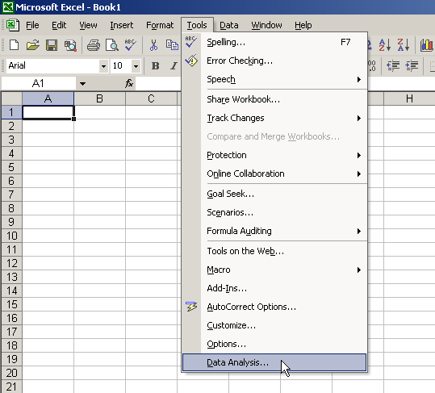
Histograms in Excel
1
Select
Tools/Data Analysis

Slide 46
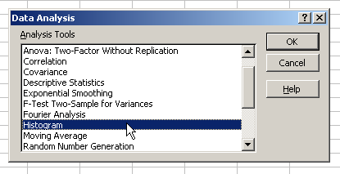
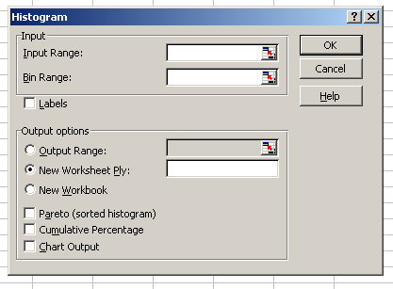
Histograms in Excel
(continued)
2
Choose Histogram
3
Input data and bin ranges
Select Chart Output

Slide 47
Stem and Leaf Diagram
A simple way to see distribution details in a data set
METHOD: Separate the sorted data series into leading digits (the stem) and the trailing digits (the leaves)

Slide 48
Example:
Data in ordered array:
12, 13, 17, 21, 24, 24, 26, 27, 27, 30, 32, 35, 37, 38, 41, 43, 44, 46, 53, 58
Here, use the 10’s digit for the stem unit:
Stem Leaf
1 2
3 5
12 is shown as
35 is shown as

Slide 49
Example:
Data in ordered array:
12, 13, 17, 21, 24, 24, 26, 27, 27, 30, 32, 35, 37, 38, 41, 43, 44, 46, 53, 58
Completed Stem-and-leaf diagram:
Stem | Leaves
1 | 2 3 7
2 | 1 4 4 6 7 8
3 | 0 2 5 7 8
4 | 1 3 4 6
5 | 3 8

Slide 50
Using other stem units
Using the 100’s digit as the stem:
Round off the 10’s digit to form the leaves
613 would become 6 1
776 would become 7 8
. . .
1224 becomes 12 2
Stem Leaf

Slide 51
Chapter Summary
Data in raw form are usually not easy to use for decision making -- Some type of organization is needed:
♦ Table ♦ Graph
Techniques reviewed in this chapter:
Frequency Distributions and Histograms
Bar Charts and Pie Charts
Stem and Leaf Diagrams
Line Charts and Scatter Diagrams

